Slide 1
CSC5-II: Controlled Use Of Administrative Privileges

Slide 2
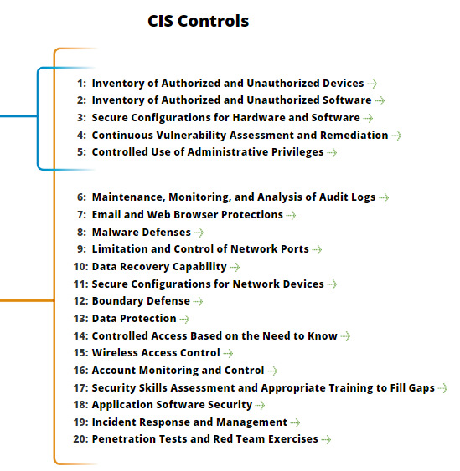
CSC5-II: Controlled Use Of Administrative Privileges
https://www.cisecurity.org/controls/

Slide 3
CSC5-II: Controlled Use Of Administrative Privileges
5.6: Use multifactor authentication for all administrative access, including domain administrative access.

Slide 4
CSC5-II: Controlled Use Of Administrative Privileges
5.6…: Multi-factor authentication can include a variety of techniques, to include the use of smart cards, certificates, One Time Password (OTP) tokens, biometrics, or other similar authentication methods.

Slide 5
CSC5-II: Controlled Use Of Administrative Privileges
5.7: Where multi-factor authentication is not supported, user accounts shall be required to use long passwords on the system (longer than 14 characters).

Slide 6
CSC5-II: Controlled Use Of Administrative Privileges
5.8: Administrators should be required to access a system using a fully logged and non-administrative account.

Slide 7
CSC5-II: Controlled Use Of Administrative Privileges
5.8…: Then, once logged on to the machine without administrative privileges, the administrator should transition to administrative privileges using tools such as Sudo on Linux/UNIX, RunAs on Windows, and other similar facilities for other types of systems.

Slide 8
CSC5-II: Controlled Use Of Administrative Privileges
5.9: Administrators shall use a dedicated machine for all administrative tasks or tasks requiring elevated access.

Slide 9
CSC5-II: Controlled Use Of Administrative Privileges
5.9…: This machine shall be isolated from the organization's primary network and not be allowed Internet access. This machine shall not be used for reading e-mail, composing documents, or surfing the Internet.
END

